Slide 1

Predicting House Prices Using Image Detection
Milestone 1
Kaitlyn Chen, Ryan Guo, Jonathan Wang
GenAI Gurus

Slide 2
Topic & Previous Solutions
Develop a model for multi-step time series prediction of the sale price of houses based on image detection
Example Solution: https://www.sciencedirect.com/science/article/pii/S2667305322000217
Study using Deep convolutional neural networks (CNNs)
Estimates house prices based on attributes such as interior, exterior, and satellite images
Created a model with the strength of being trained on visual information
Example Solution: https://github.com/tncy67/House-Price-Prediction-via-Computer-Vision
CNNs for predicting prices based on images of the front of the house

Slide 3
Datasets
With prices:
https://www.kaggle.com/datasets/ted8080/house-prices-and-images-socal
Exterior housing images and pricing dataset containing 8 variables & 15000+ rows in SoCal
https://www.kaggle.com/competitions/house-price-estimation/overview
Images inside & outside house with prices of houses in Cali
Without prices:
https://www.kaggle.com/datasets/robinreni/house-rooms-image-dataset
Around 3000 collective images of Bathroom, Bedroom, Living Room, Dining, & Kitchen spaces
https://www.kaggle.com/datasets/mikhailma/house-rooms-streets-image-dataset
Includes several image categories of the previous dataset including new ones for streets
https://paperswithcode.com/dataset/interiornet
20M sample dataset of interior scenery

Slide 4
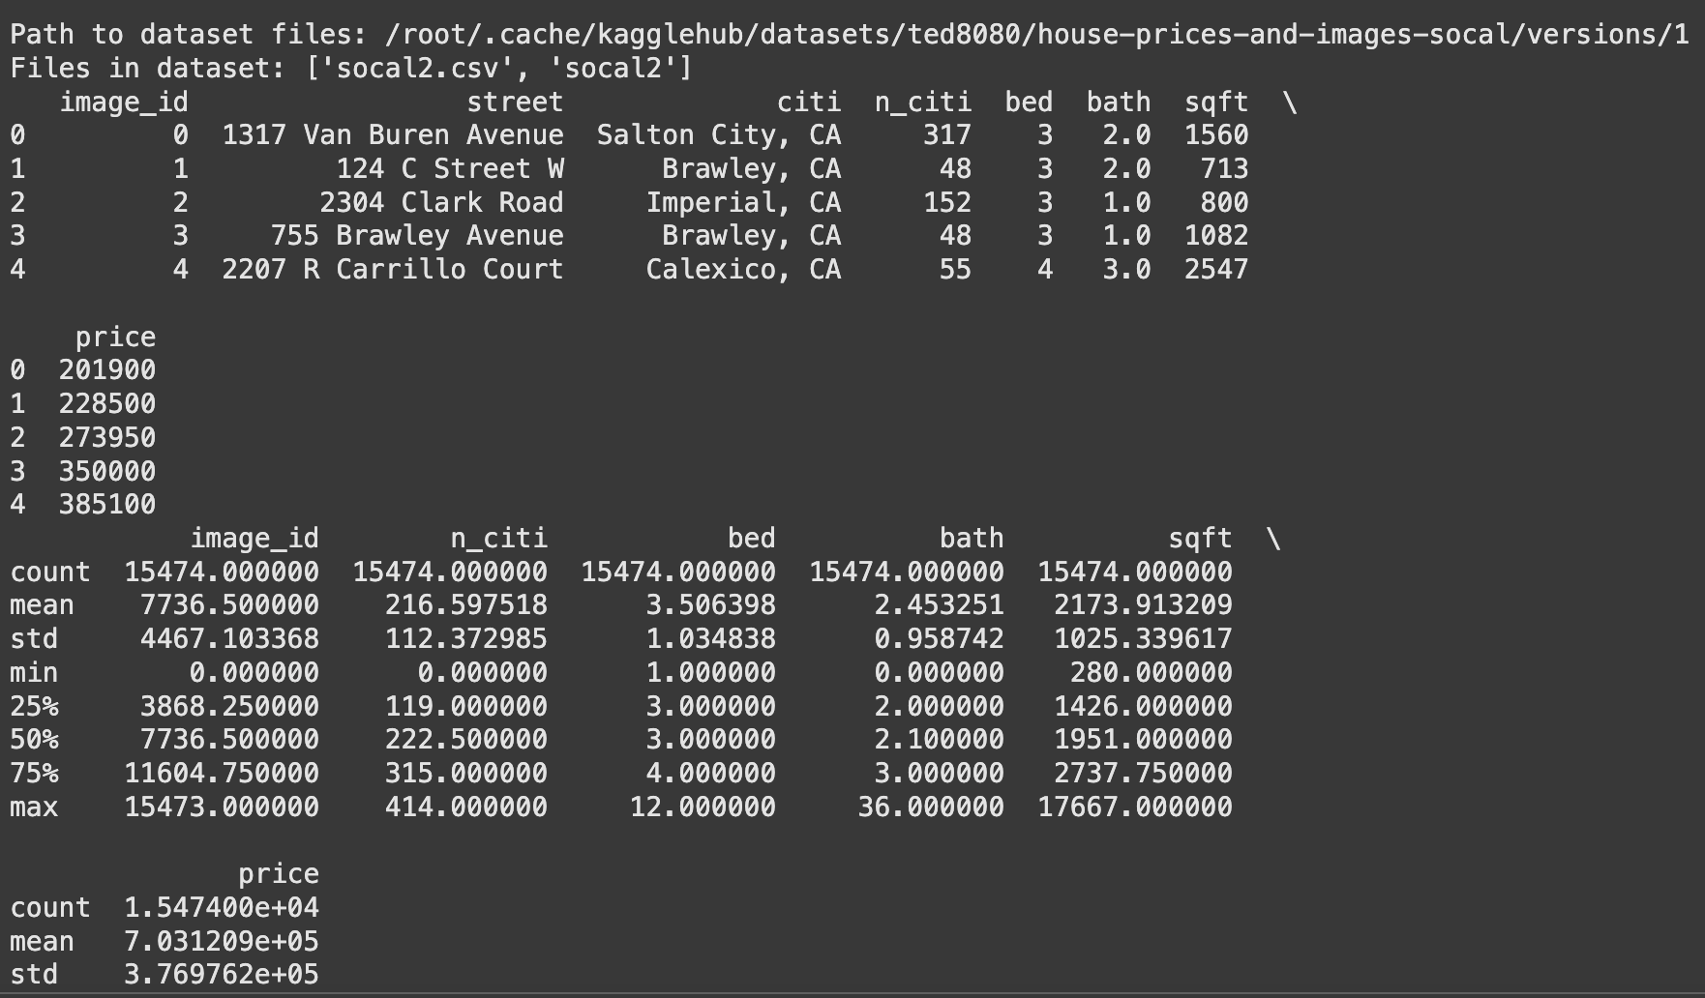
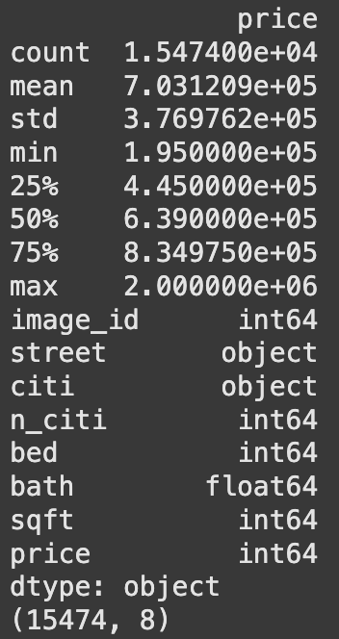
Data exploration
Socal Dataset: street, ~15.5k images of exterior; columns: city, # bed, # bath, sqft, price
House Price Estimation Dataset: ~2.2k images of bathroom, bedroom, kitchen, exterior; columns: zip code, # bed, # bath, sqft, price
Initialize dataset path, search in the directory to open the CSV files
Display the first rows, summary statistics, column data types, amounts of rows & columns
Plan to feed our neural network with the imaging datasets and train the model to make accurate predictions (ex. CNN)

Slide 5
Data cleansing
Identify and fill/remove missing values in datasets (e.g., price, sqft, bed/bath count).
Convert incorrect data types (e.g., numerical values stored as strings).
Identify extreme values in price, sqft, or bed/bath count using statistical methods.
Ensure all listings have corresponding images, remove unmatched records.
Normalize categorical data (e.g., city names, zip codes) for consistency.

Slide 6
Data preparation
Merge the datasets based on common attributes (e.g., zipcode, sqft, bed/bath count).
Create new features (e.g., price per sqft, neighborhood ranking, image-based features).
Resize, normalize, and extract features from house images
Divide the dataset into training and validation sets to evaluate model performance.

Slide 7
Challenges
Missing/Incomplete Data: Difficulty in handling missing property details and inconsistent records.
Image-Text Matching Issues: Ensuring each house listing has a corresponding image for accurate predictions.
Outlier Impact: Extreme values (luxury homes, distressed properties) affecting model performance.
Data Imbalance: Uneven distribution of house prices across different zip codes and regions.

Slide 8
Questions?

